Slide 1


Recommendation Pricing Model at
General Hospital
Mohammad Abu Talha Sunny
1

Slide 2
Package Pricing at General Hospitals
Package Pricing: A patient is provided a tailored quote on treatment cost at the time of admission for a group of related services, based on the expected costs for a clinically deﬁned episode of care
Why Package Pricing at General Hospital?
Increase customer conﬁdence and make pricing policies more transparent
Dr. Eric at General Hospital was at a crossroad to:
‐ Decide whether to use package pricing or traditional pricing
‐ Design a strategy as an accurate approach to predict the package price at time of admission
‐ How to use package pricing as a competitive strategy

Slide 3
Conceptual Model
Personal Data
Age Gender BMI
Marital Status
Stay at hospital Total Length Of Stay
Length of stay-ICU Length of stay-Ward Mode Of Arrival State at Arrival Type Of Admission
Symptoms HR Pulse BP -high BP-low RR
HB
Urea Creatinine
Medical Data
Key complaint codes
Past medical history code
Implant (Y/N)

Slide 4
The ﬁve assumptions of regression analysis
Linear relationship: There exists a linear relationship between the independent and dependent variable
No or little multicollinearity: more than two explanatory variables should not be highly linearly related
No autocorrelation: no correlation between residuals
Normality: The residuals of the model are normally distributed
Homoscedasticity: The residuals have constant variance at every level of independent variable

Slide 5
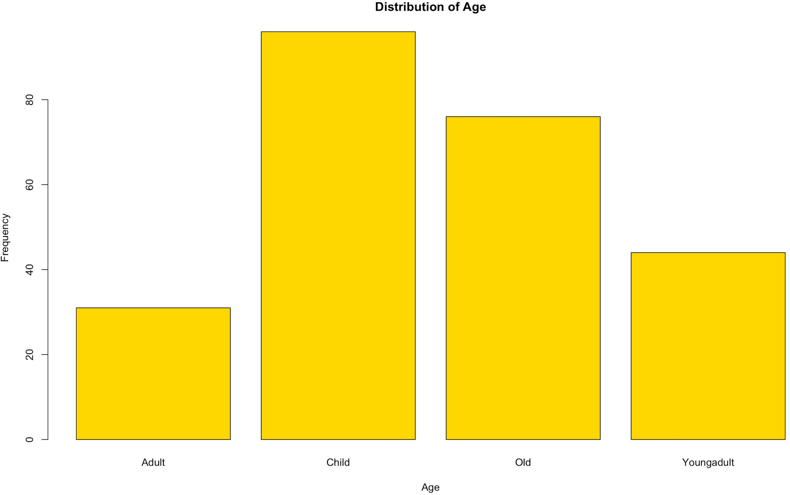
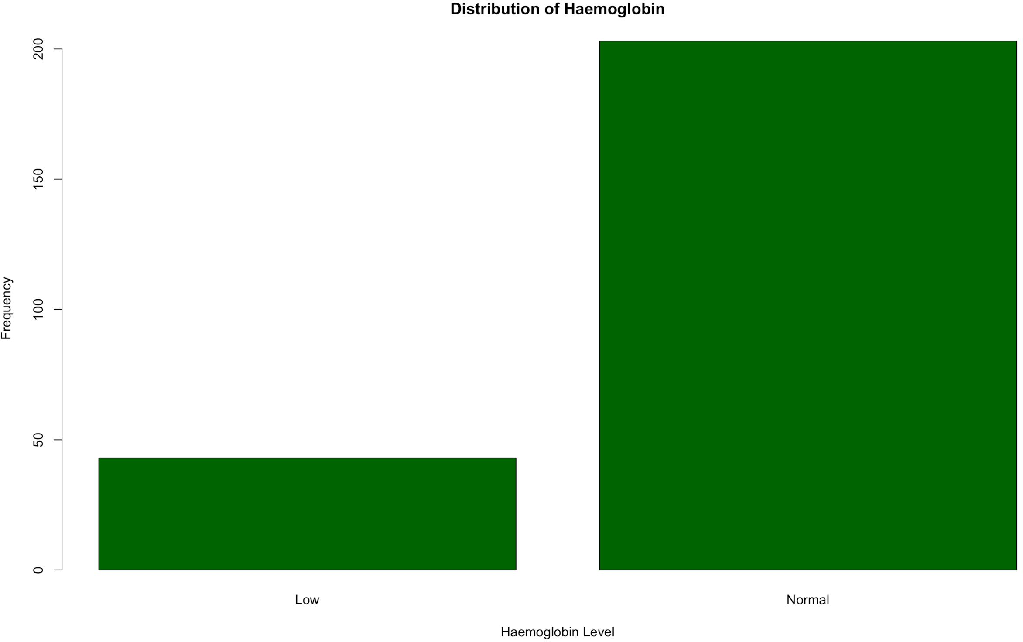
Data Preparation
Age Categories (per case study appendix) age <10: Child
age 11-25: Young Adult age 26-50: Adult
age >50: Old
Haemoglobin (per subject matter knowledge) "normal": Female 12 to 15.5 and Men 13 to 17.5 Any value outside these limits will be "abnormal"

Slide 6
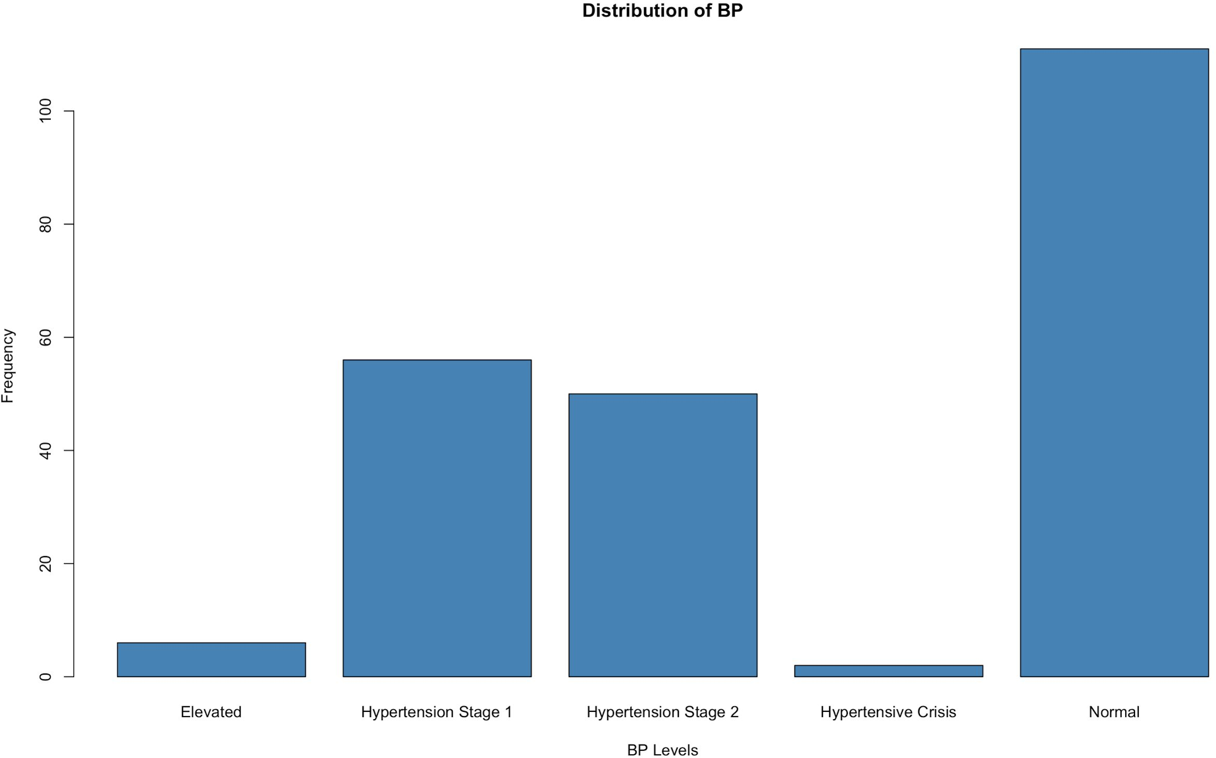
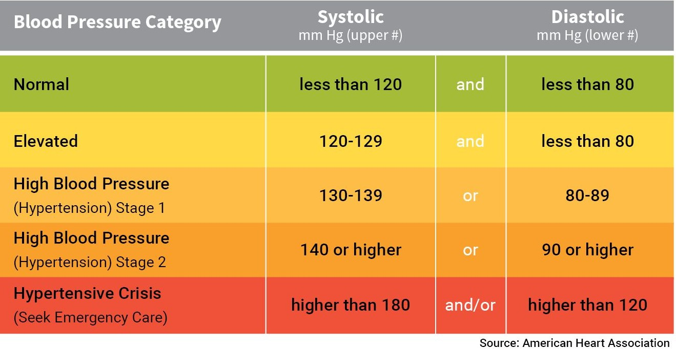
Derived Variables
BP Ranges (per subject matter knowledge)
Urea Categories (Per subject matter knowledge)
Female: 6 to 21 mg/dl: Normal Male: Urea 7 to 20 mg/dl: Normal Urea > 20 mg/dl: Abnormal

Slide 7
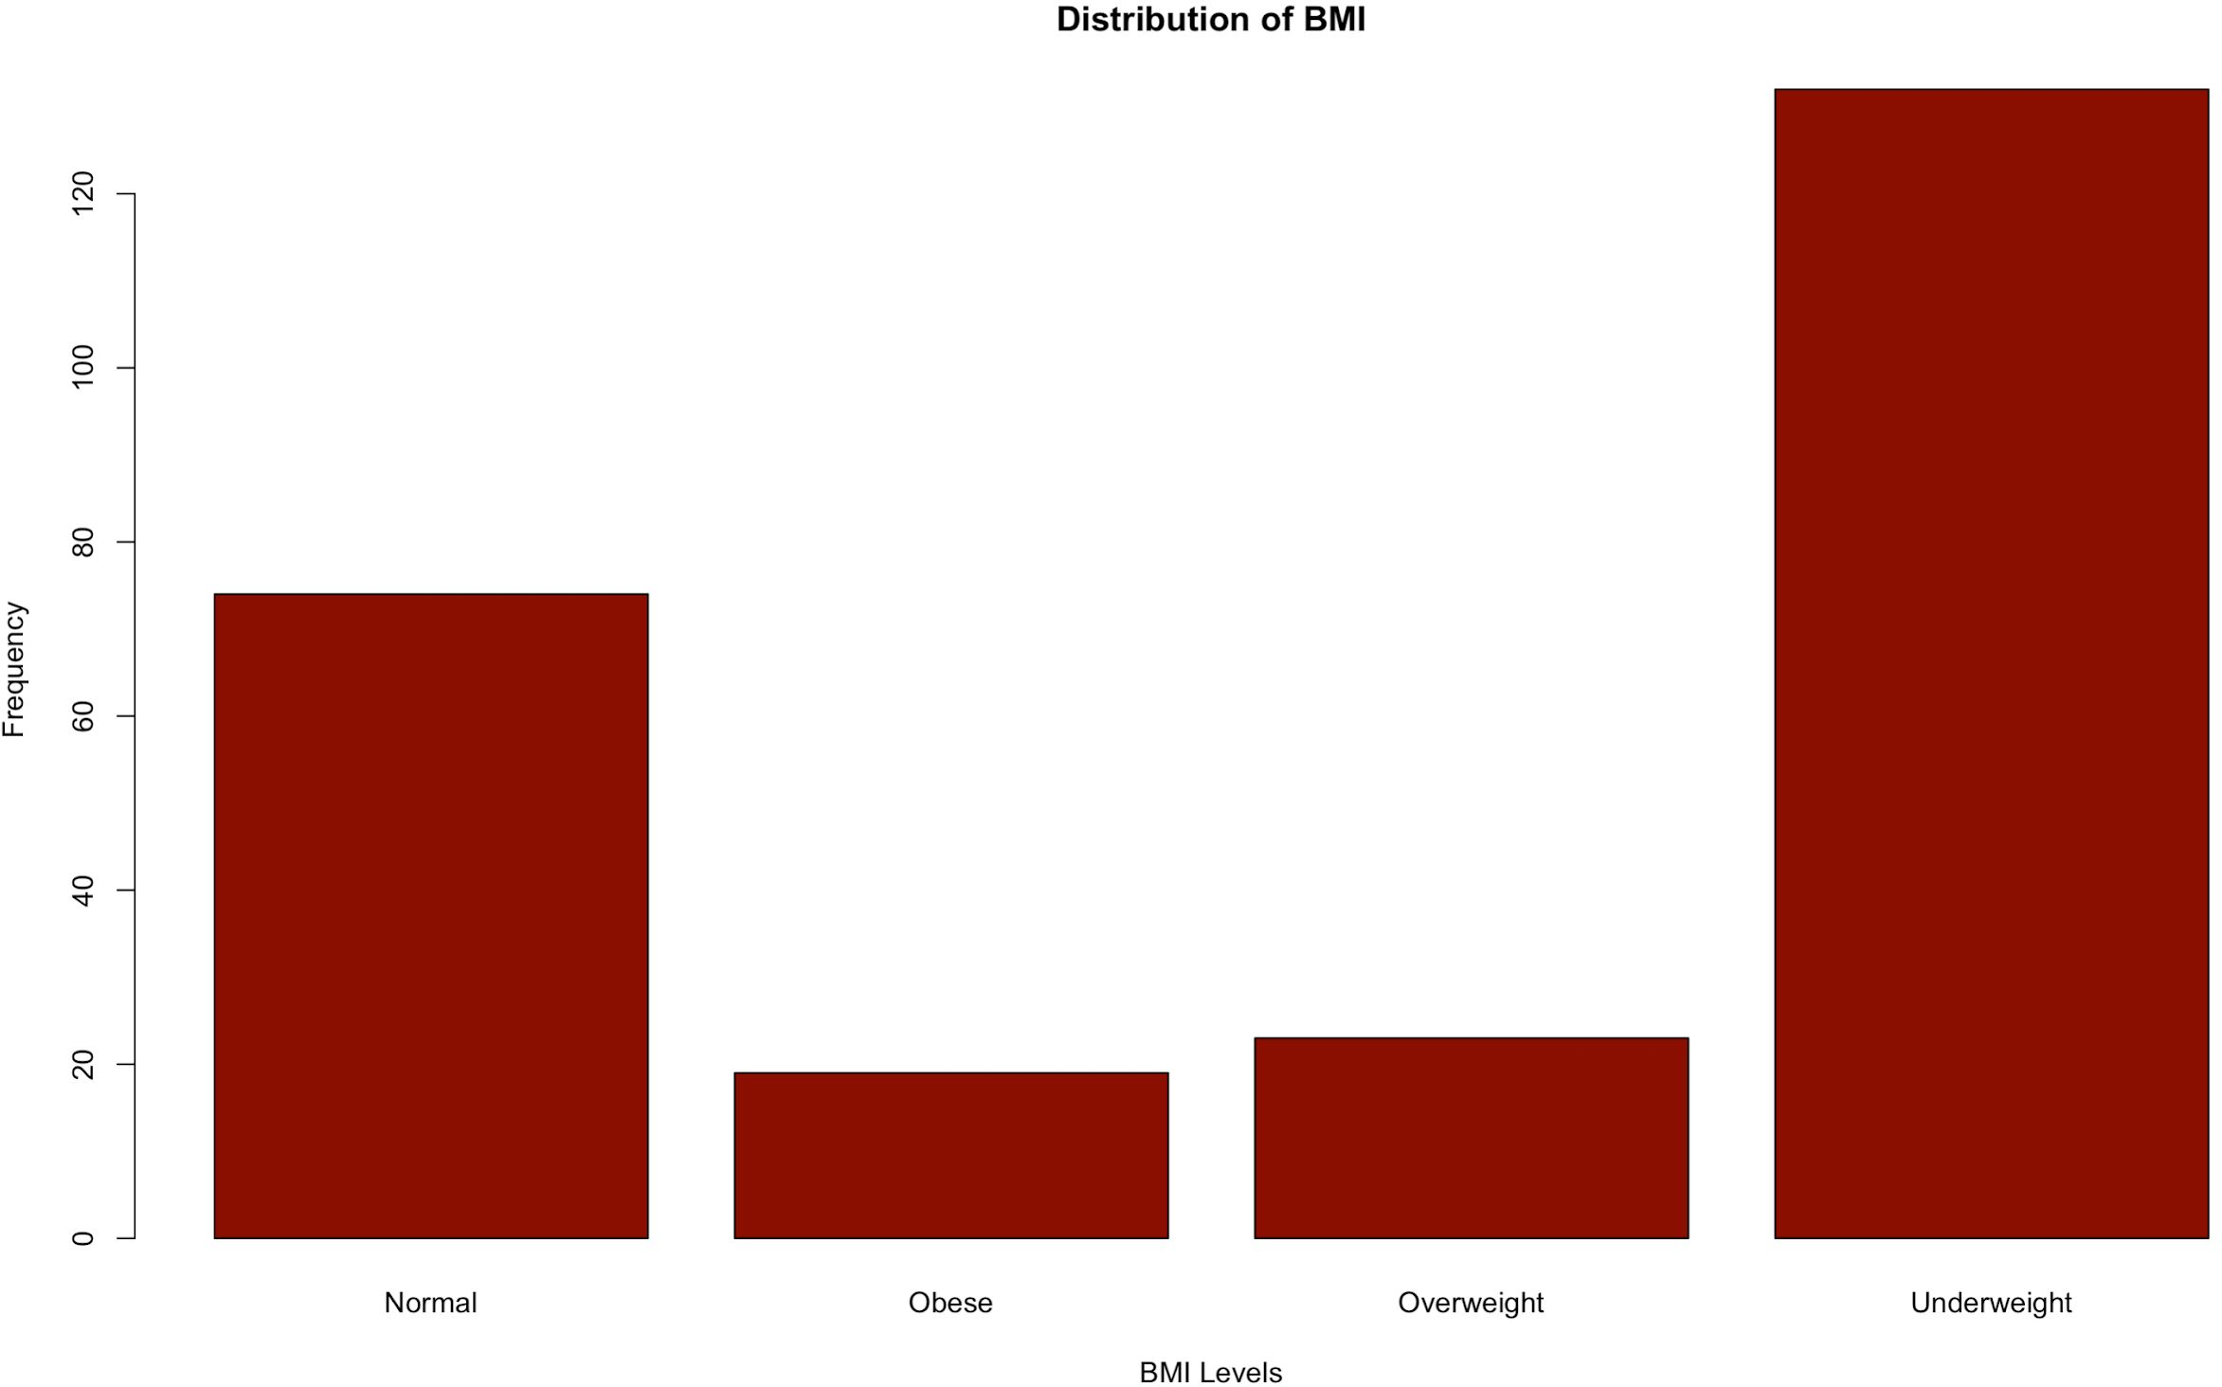
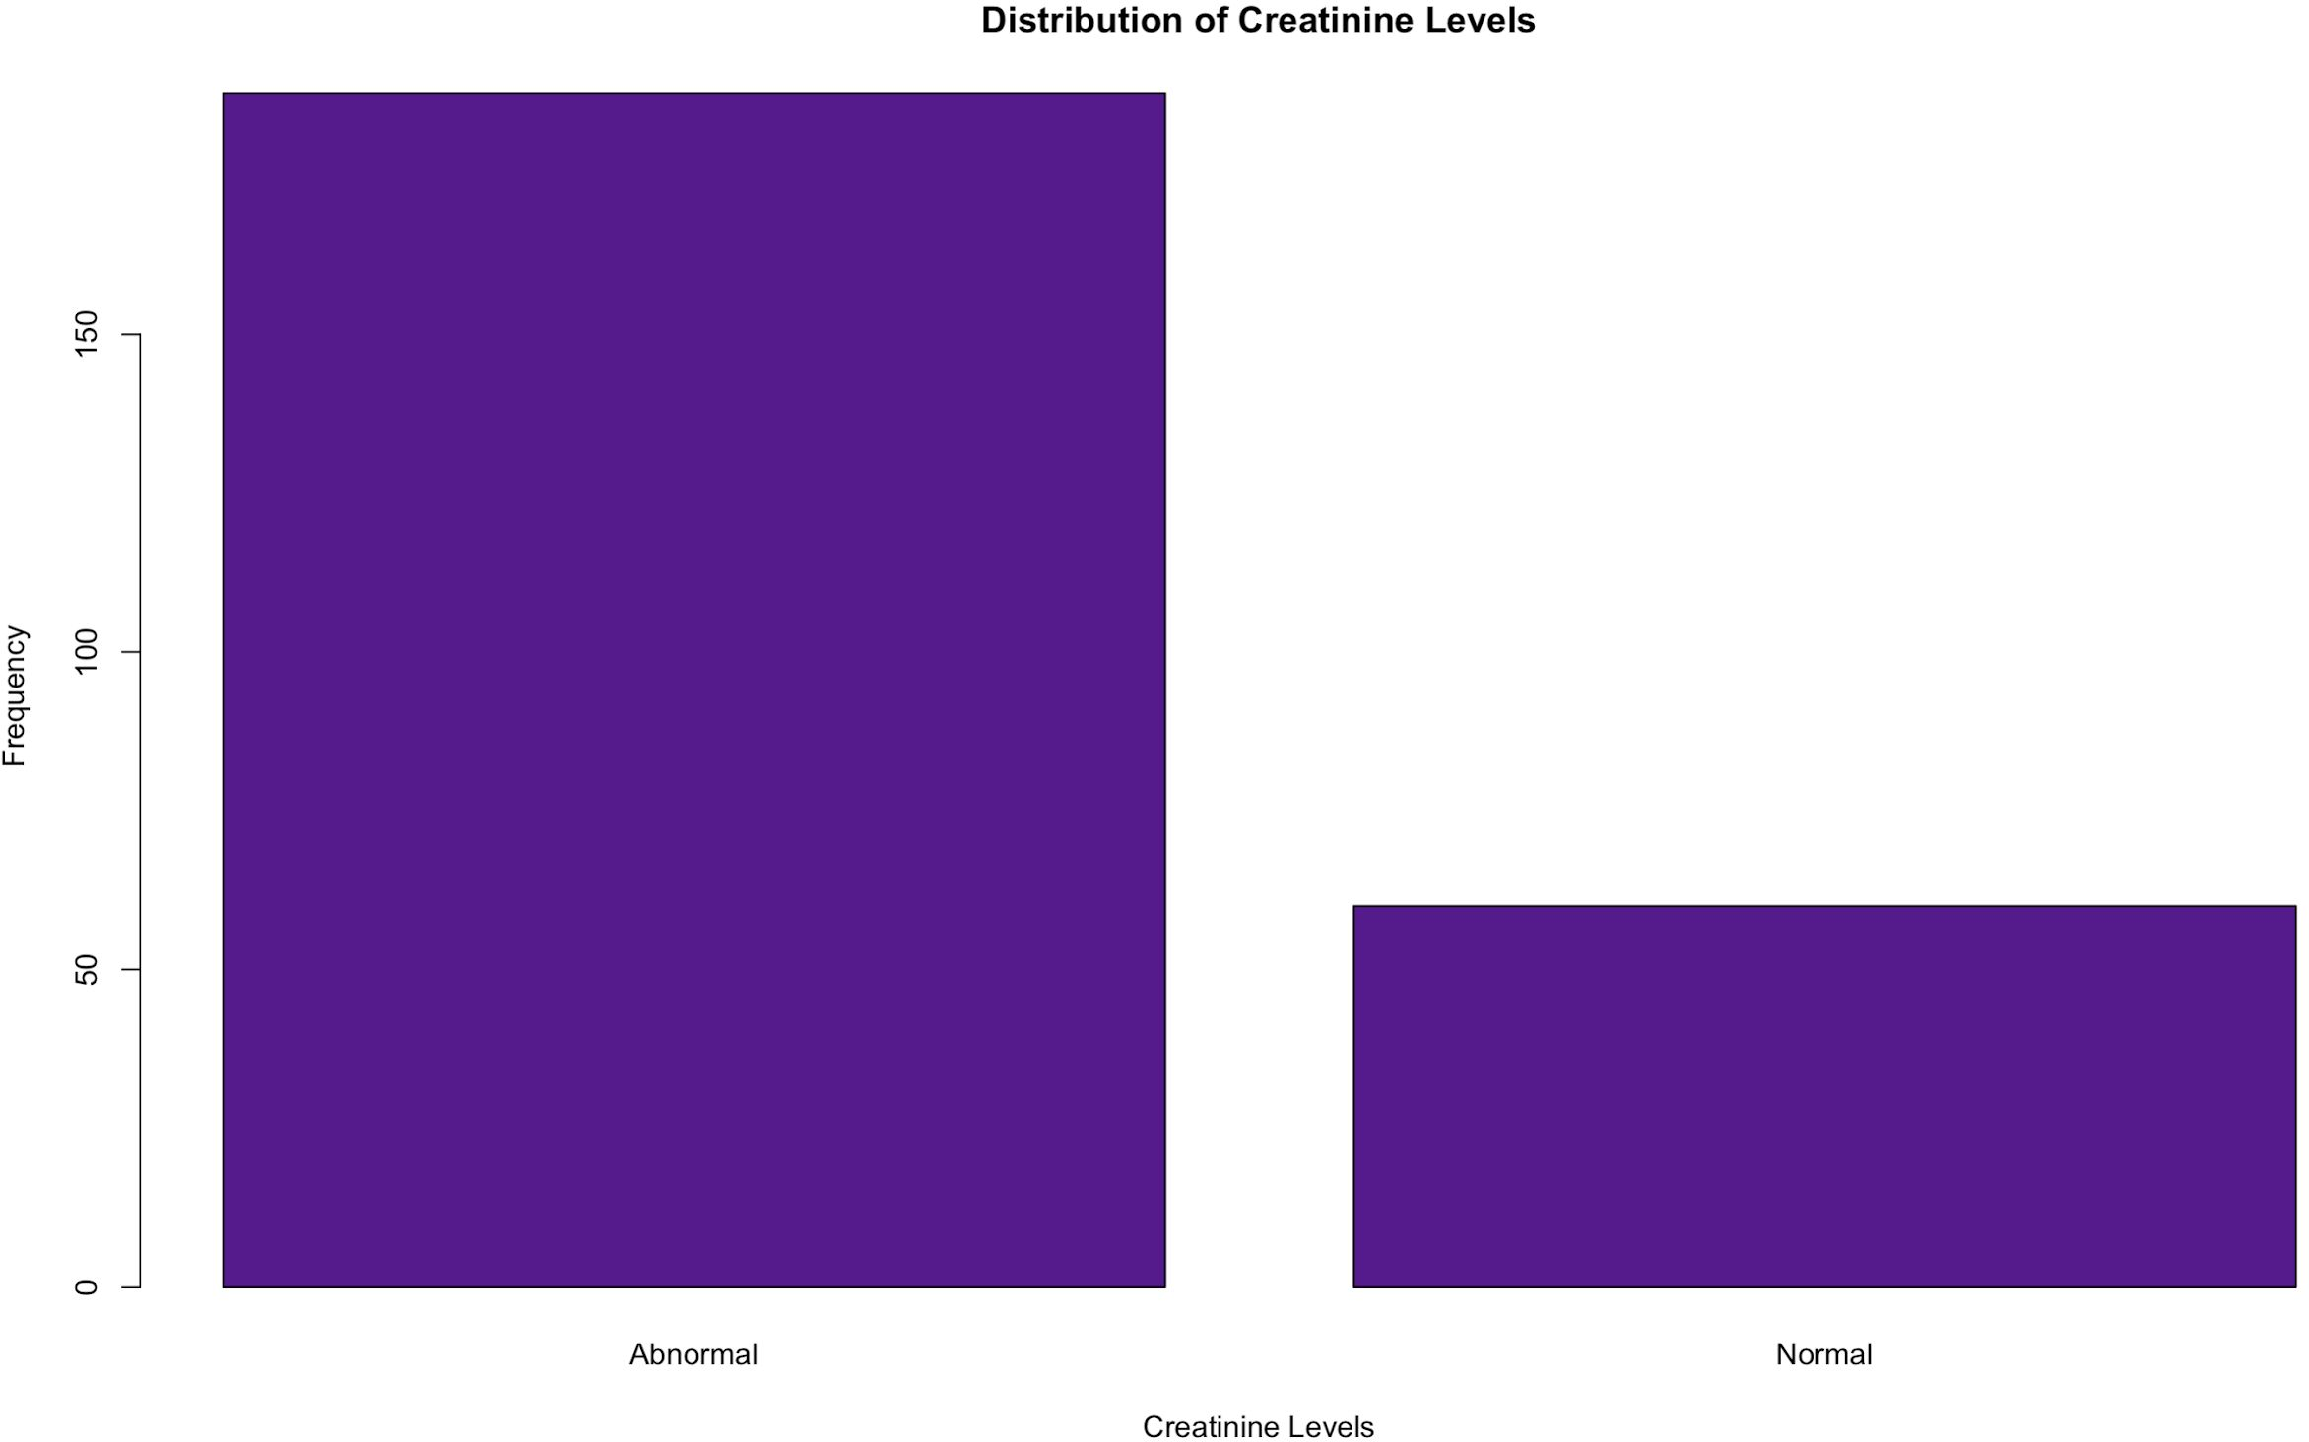
Data Preparation
BMI Categories (Per subject matter knowledge)
BMI <18.5: Underweight
BMI <25: Normal
BMI 25 - 30: Overweight BMI > 30: Obese
Creatinine Categories (Per subject matter knowledge)
Age <3 & creatinine: 0.3-0.7 Normal
Age: 3-18 & creatinine: 0.5-1.0 Normal Age >18 & Female & creatinine: 0.6 - 1.1 Normal Age > 18 & Male & creatinine: 0.9 - 1.3 Normal Else: Abnormal

Slide 8
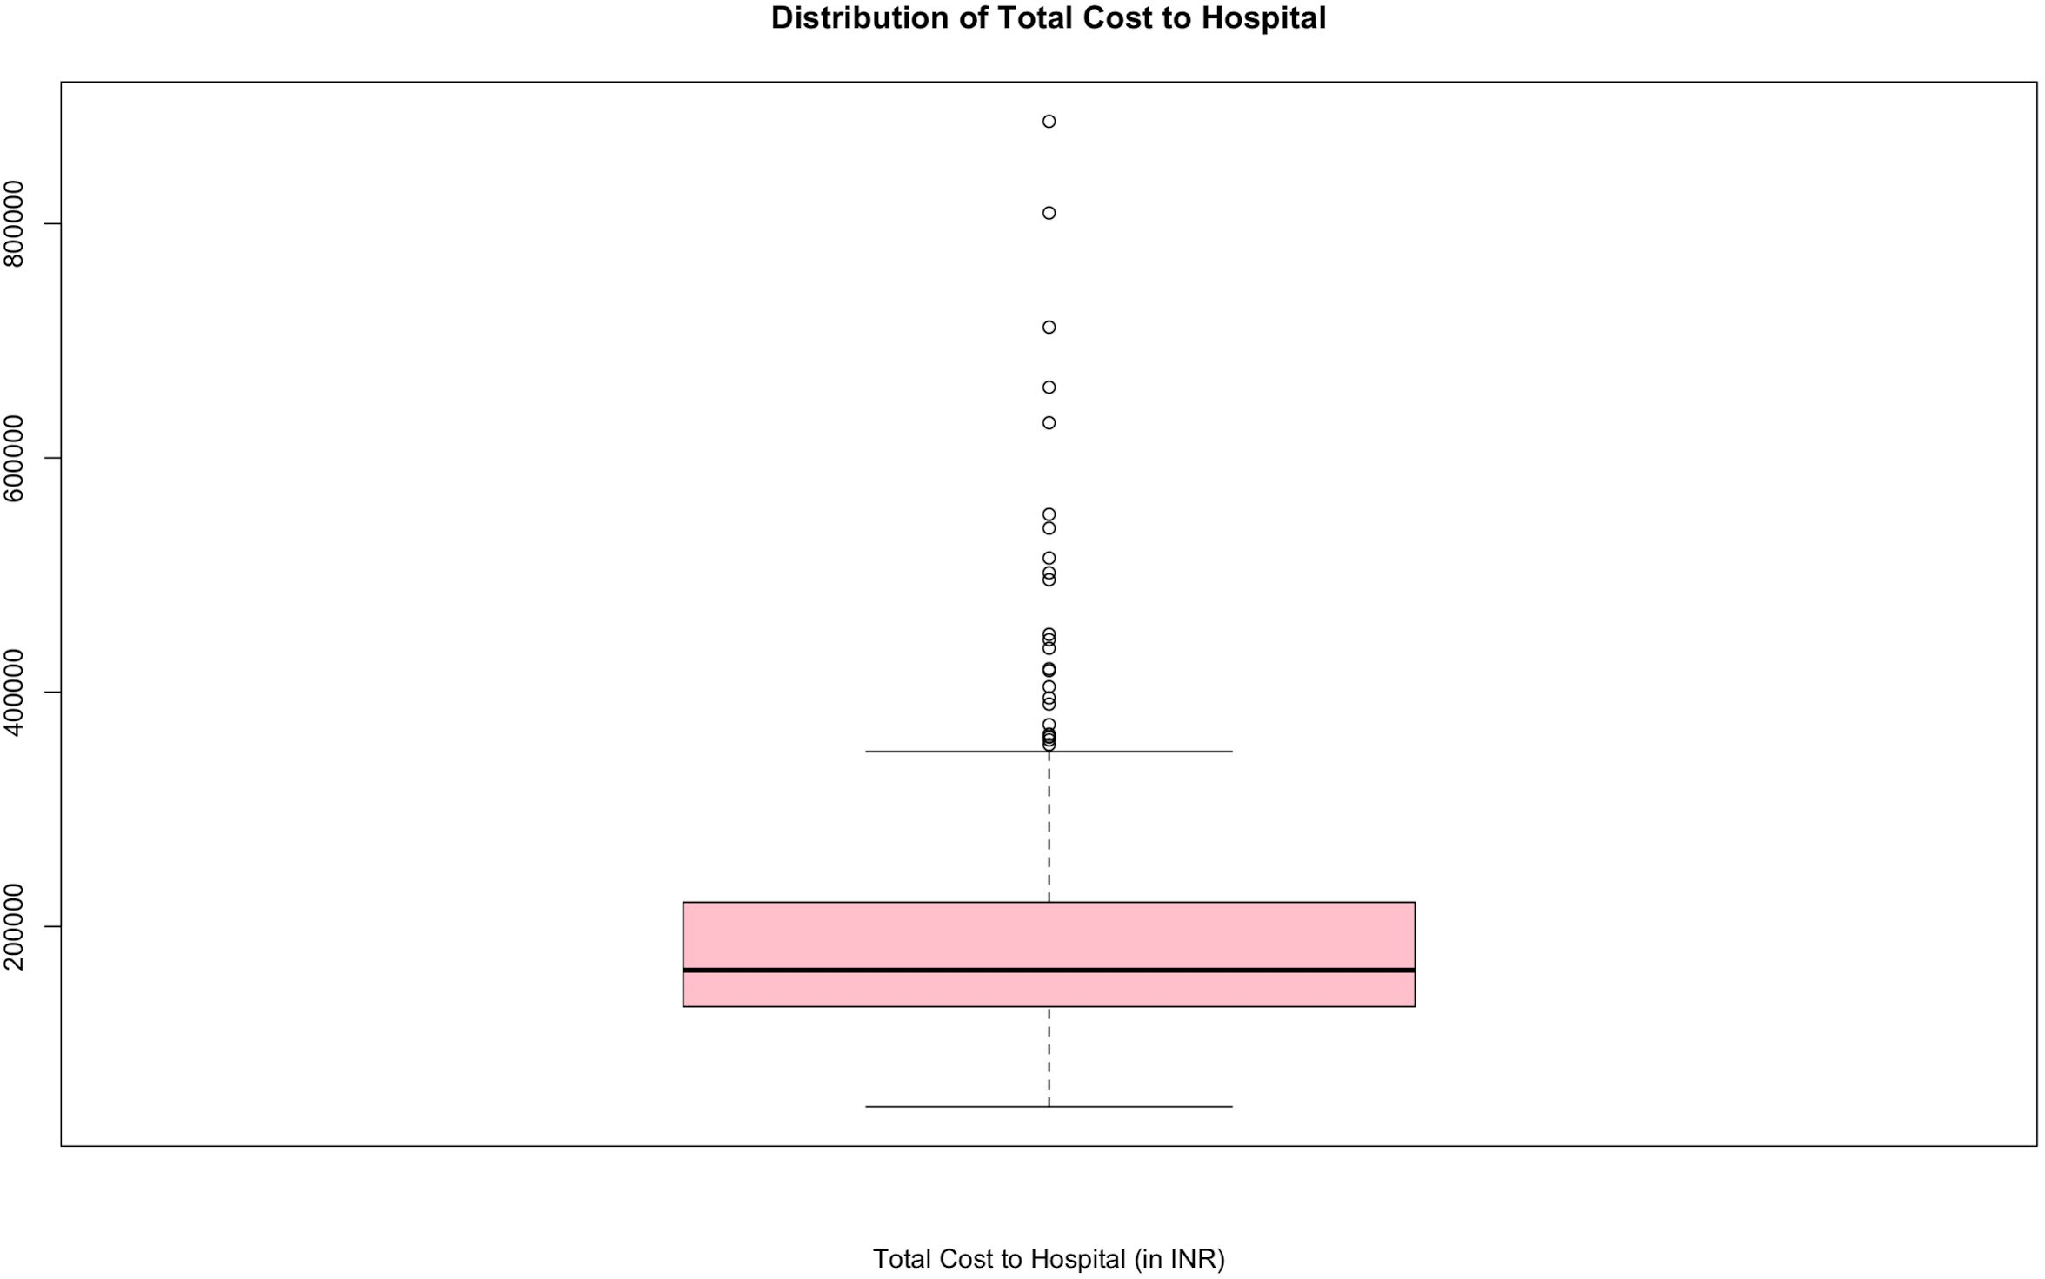
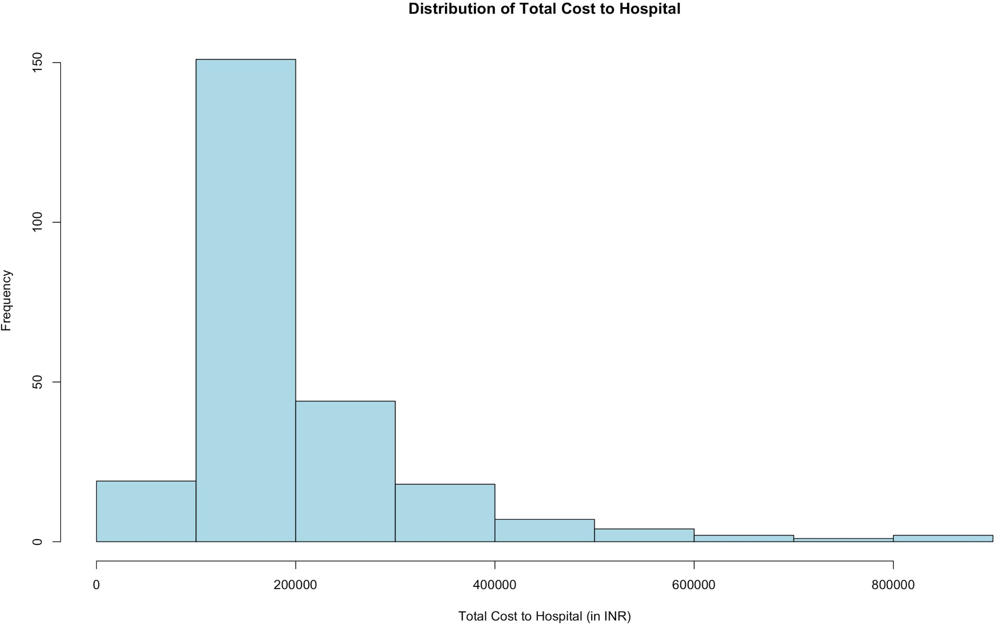
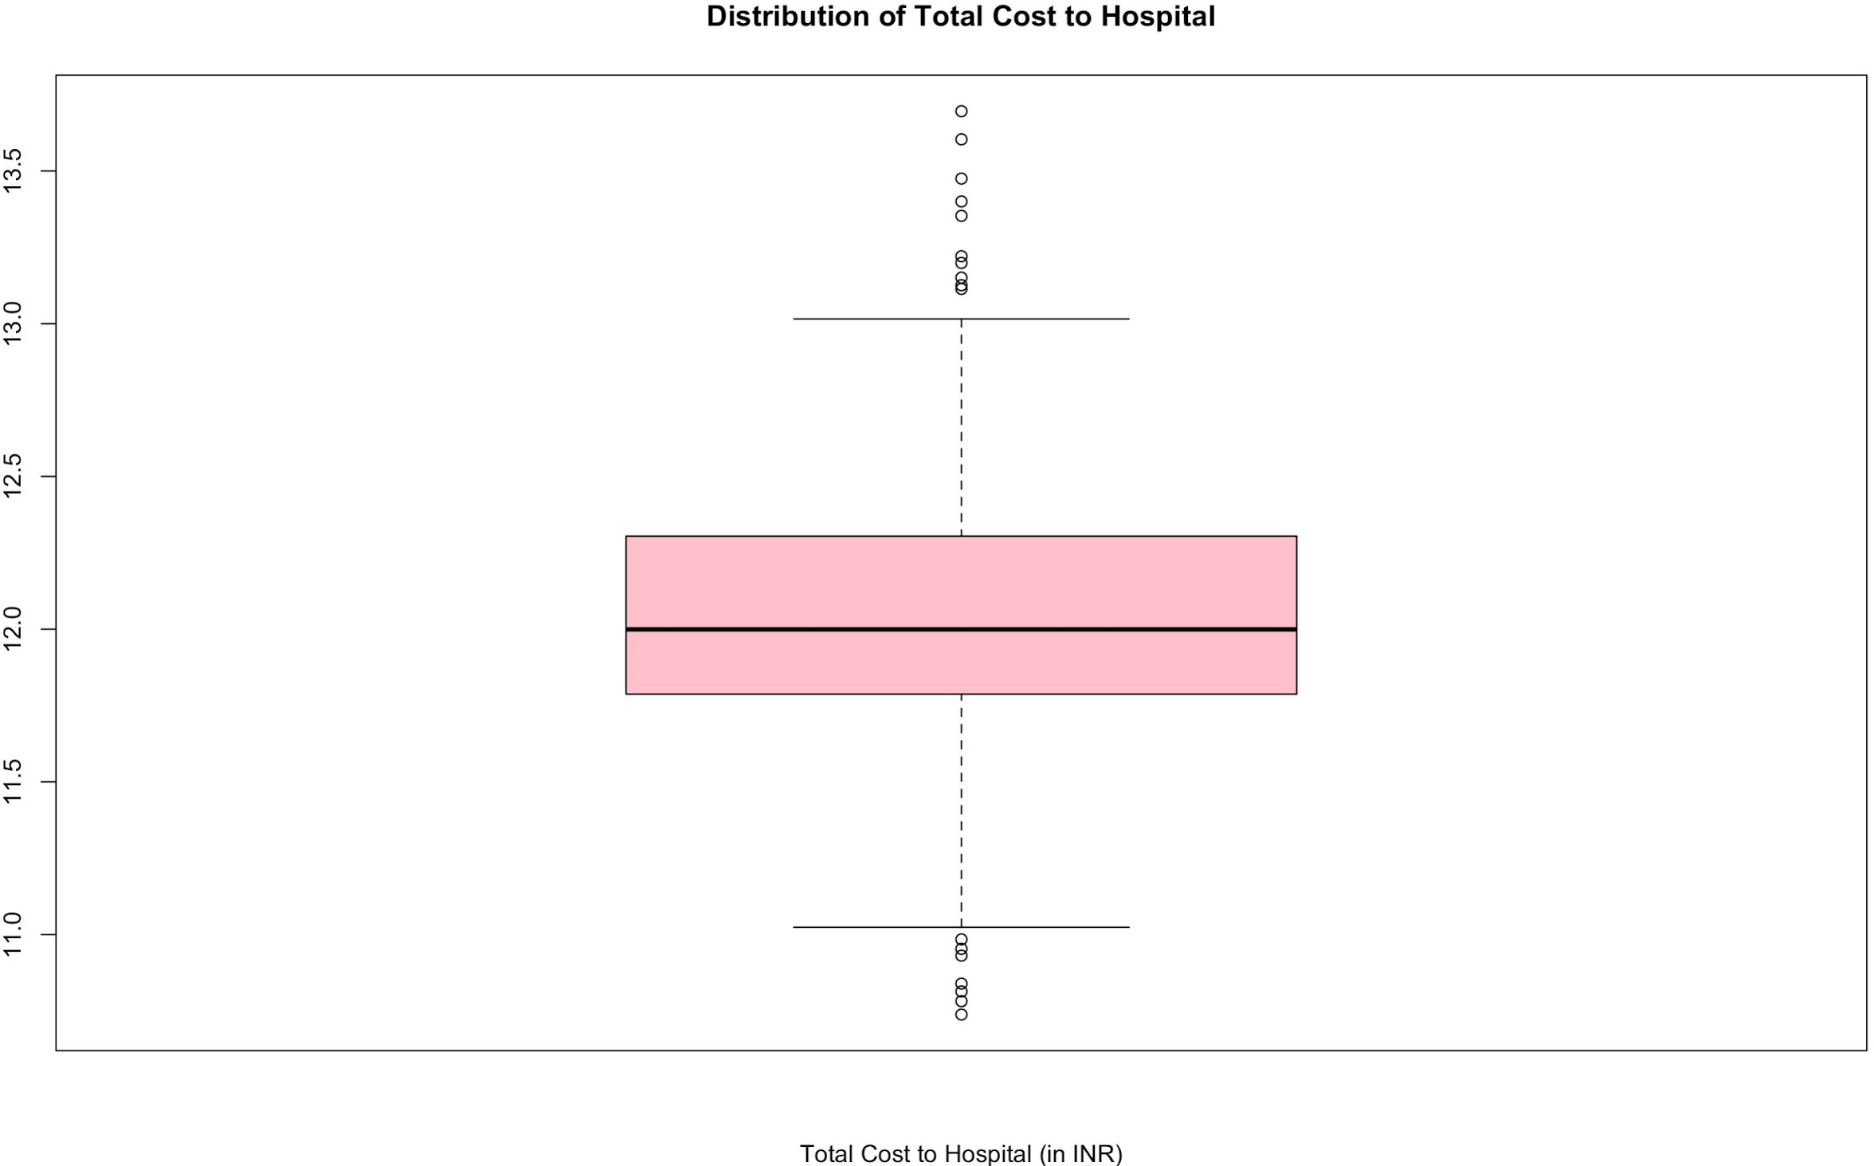
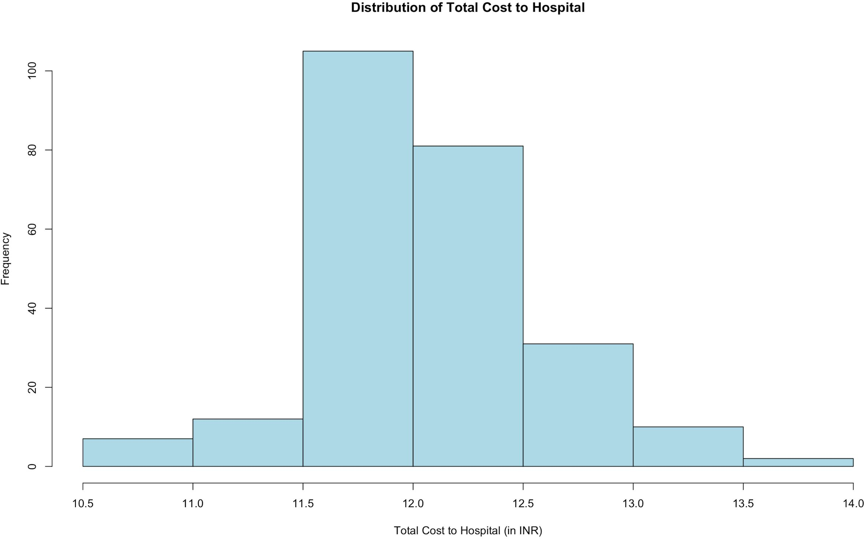
Dependent Variable - Univariate Analysis
Ln (Total Cost)

Slide 9
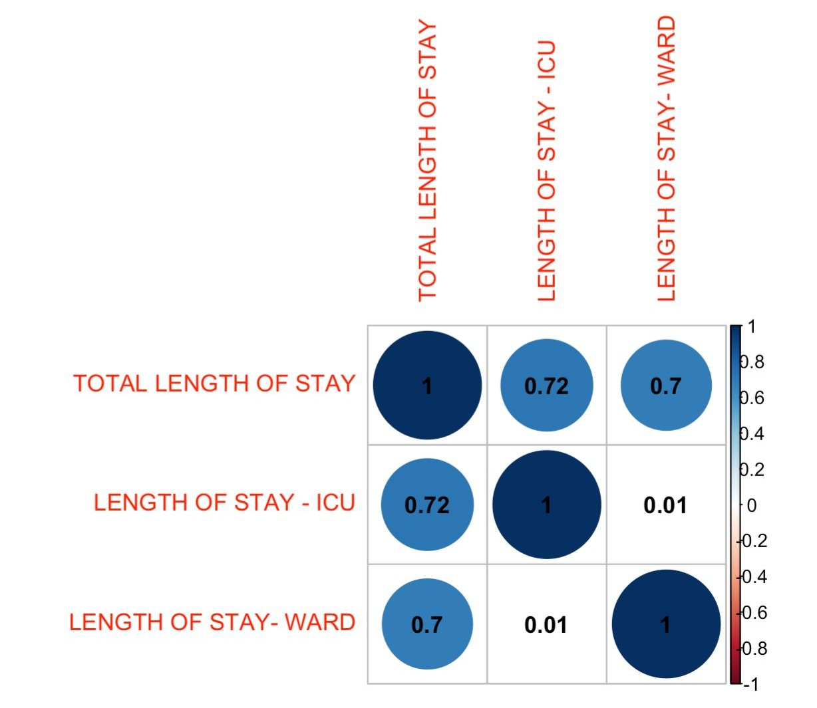
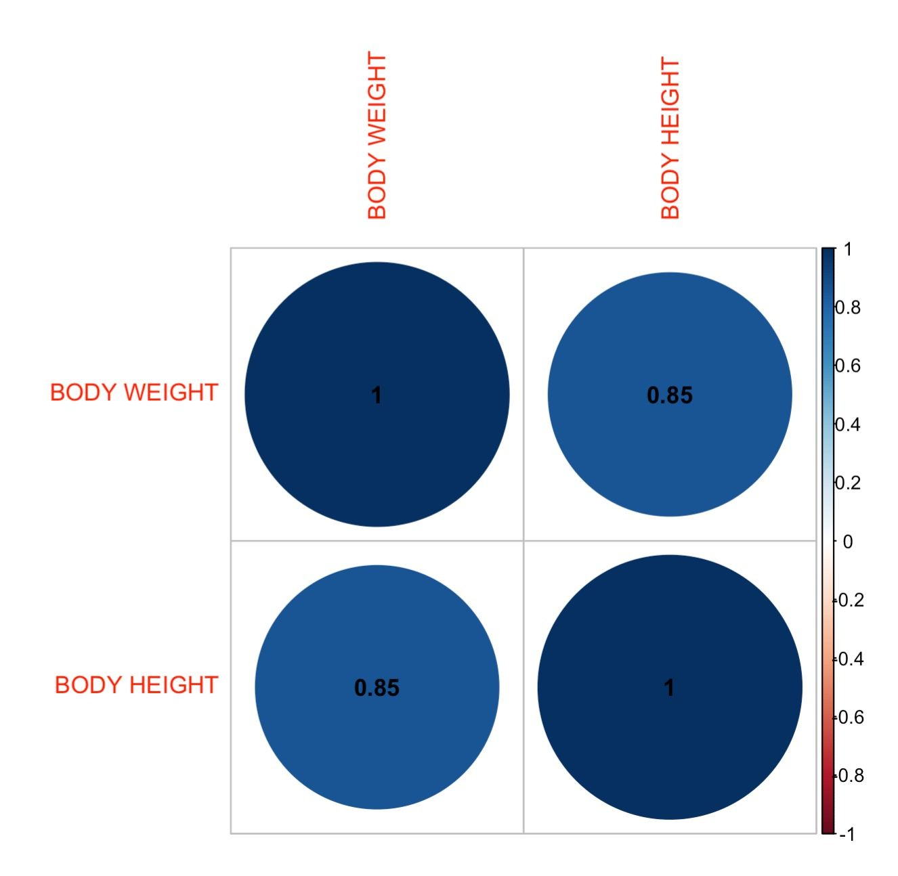
Data Preparation
Total Length of Stay is highly correlated with dependent variable, Length of Stay in the ICU and Ward
Body Height and Body Weight are highly correlated → created new variable BMI to avoid multicollinearity
BP-High and BP-Low are correlated as well → deﬁned new variable with both BP variables

Slide 10
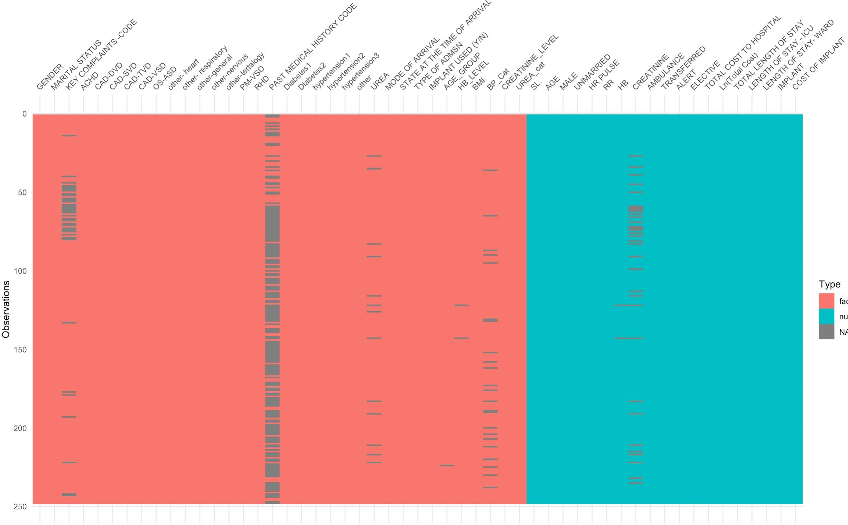
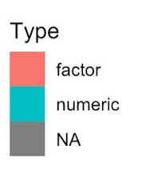
Handling NULL values
BP imputed 'Normal' for null values with juvenile patients (age <10)
Urea Imputed 'Normal' for 11 null values and outliers
(Assumption: Urea measurement is not critical for that patient)

Slide 11
Statistical Tests & Variable Reduction
Statistical tests were performed on variables and removed following variables on account of statistical insigniﬁcance
other-heart
Haemoglobin
other-nervous
PM-VSD
other-respiratory
Gender
Diabetes1
CAD-SVD
Hypertension2
CAD-VSD
Hypertension3
Creatinine
Urea

Slide 12
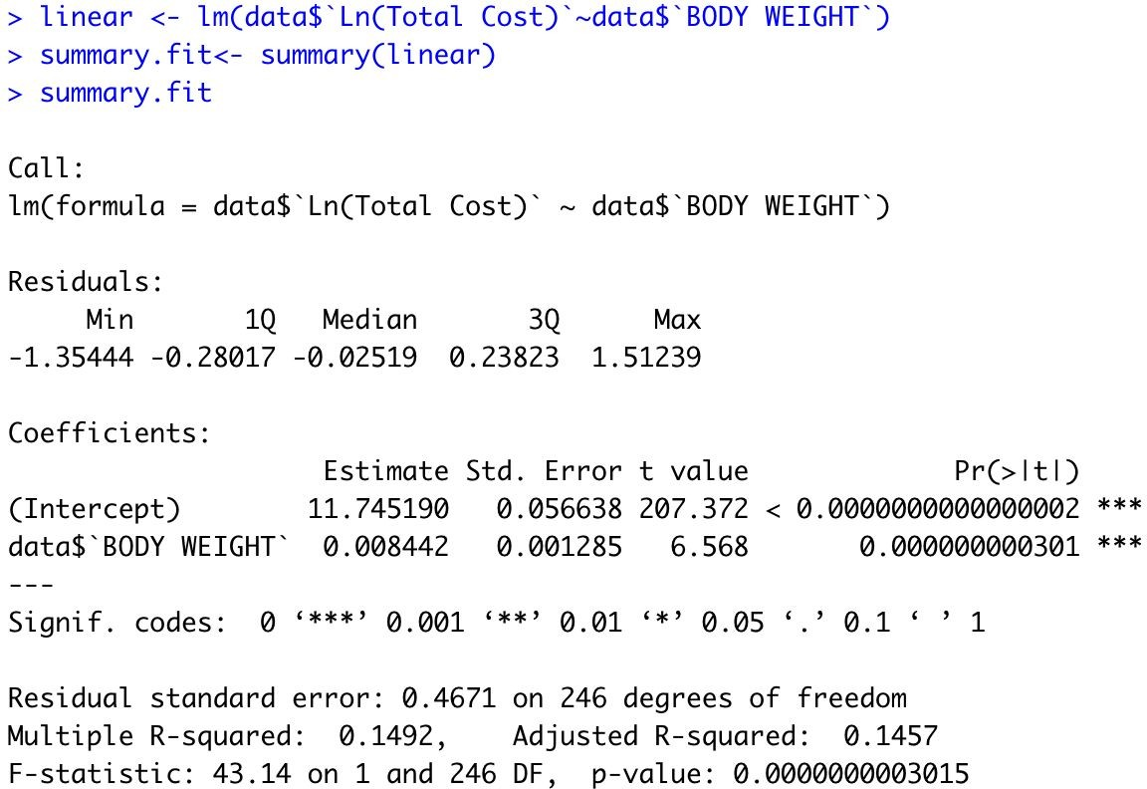
Impact of Body Weight on Total Cost
Body weight and total cost relationship
Equation:
Ln(Total Cost) = 11.745+0.0084 (Body Weight)
With every unit increase in the weight, there will be 0.84% increase in the logarithmic total cost of the treatment
The average cost for a patient weighing 50 kg is INR 198,723
= 198723*0.0084
= INR 1669.27
A patient weighing 51 kg will pay INR 1,669 more than a patient weighing 50 kg

Slide 13
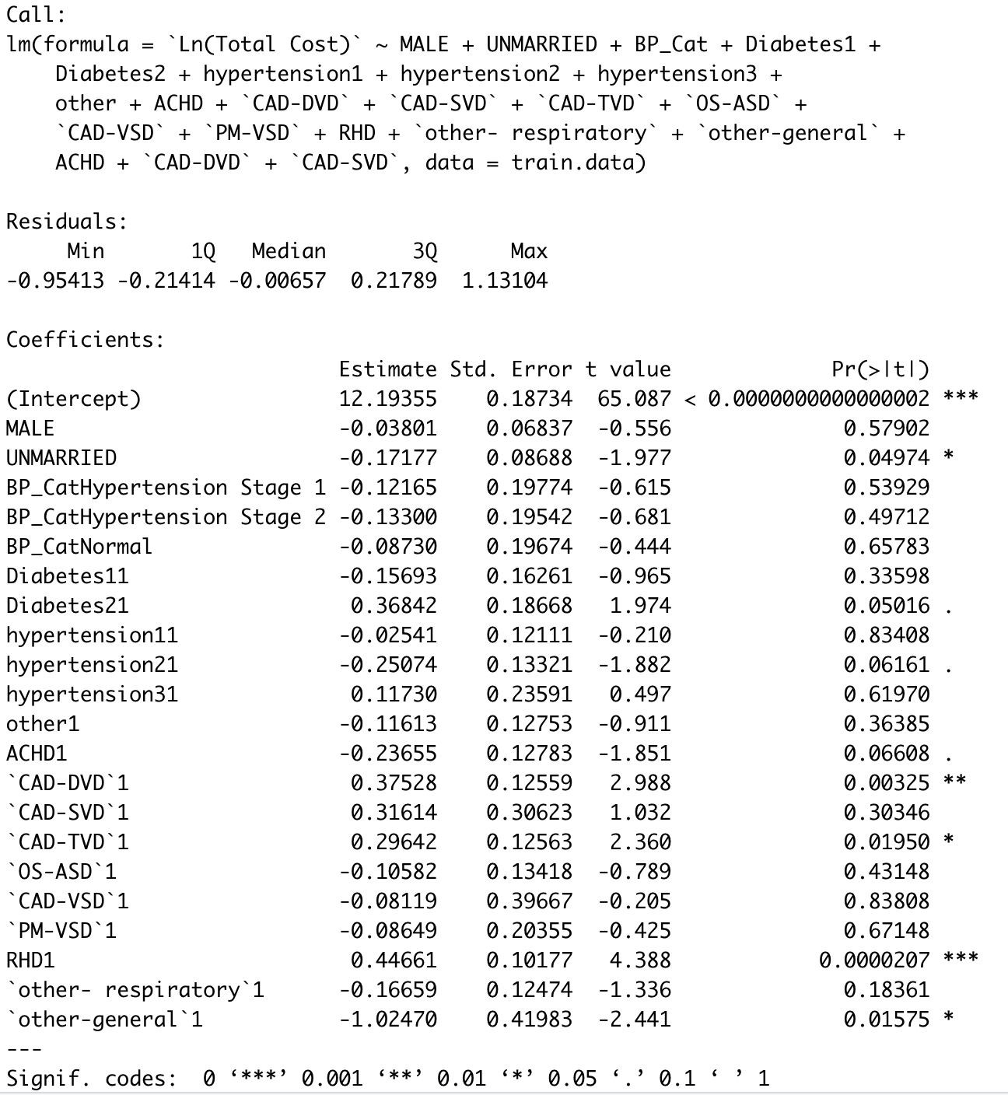
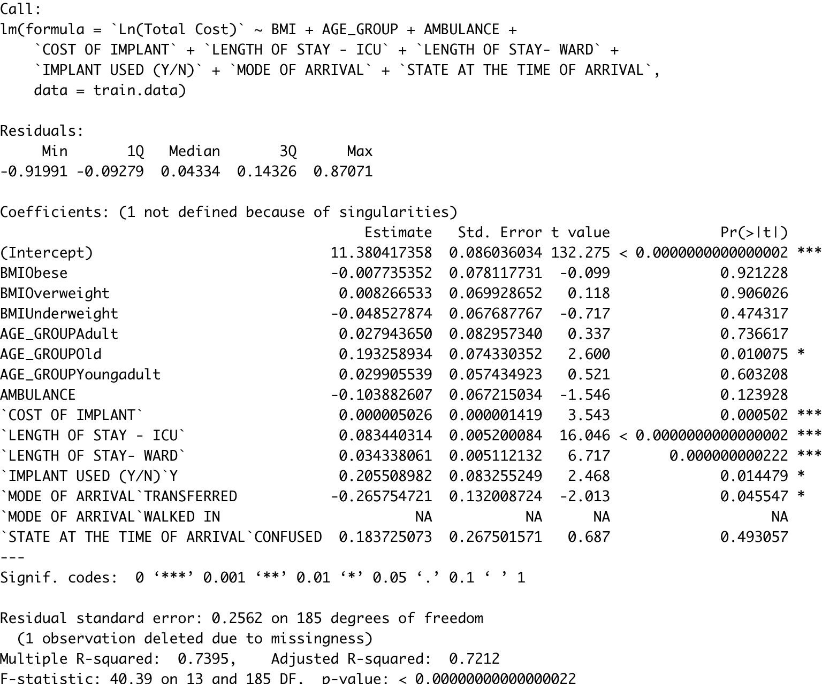
Multiple regression models to identify signiﬁcant predictors

Slide 14
Recommended Model
Length of stay - ICU
Length of stay - Ward
Mode of Arrival: Transferred
Rheumatic Heart Disease (RHD)
Coronary Artery Disease - Double Vessel Disease (CAD-DVD) Coronary Artery Disease - Triple Vessel Disease (CAD-TVD) Cost of Implant
Age group: OLD Unmarried
Model | Adjusted R-squared | RMSE
1: medical data | 29.87% | 0.5043
2: others | 84.28% | 0.2572
Ensemble | 80.64% | 0.2329

Slide 15
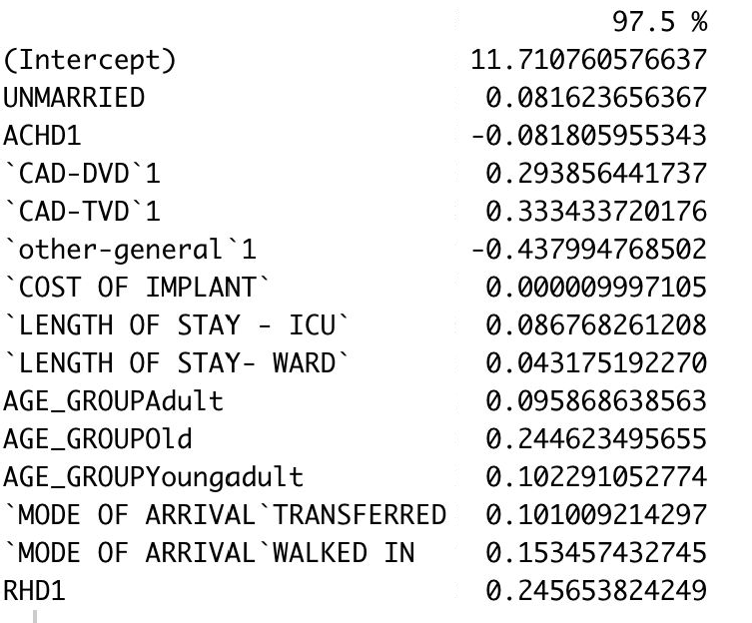
Recommended Model & Inferences
For a patient with CAD-DVD, predicted cost of treatment can increase by 29.38% when compared with a person who does not come in with CAD-DVD
If a patient spends one more day in the ICU, the cost increases by 8.67% and a day more in ward increases the cost by 4.31%
A patient aged 51 years will have the predicted cost of treatment increased by 24.4% when compared to a patient of 50 years
Ln(Total Cost) ~ a₁*Diabetes2 + a₂*ACHD + a₃*CAD-DVD + a₄*CAD-TVD + a₅*other-general +
a₆*COST OF IMPLANT + a₇*LENGTH OF STAY - ICU + a₈*LENGTH OF STAY- WARD + a₉* IMPLANT USED (Y/N) + a₁₀*AGE_GROUP

Slide 16
Should General Hospital adopt Package Pricing?
Potential Advantages | Affected Party
Decreased health care costs and improved care coordination | Payers, Patients
Discourage unnecessary care | Payers, Patients
Strong incentive to avoid complications and readmissions | Payers, Patients
Increase transparency for costs of care | Payers, Patients
Expanded referral base and increased market share due to preferred agreements | Providers
Potential Disadvantages | Affected Party
Difﬁculty deﬁning discrete episodes of care for chronic conditions | Providers
Potential avoidance of necessary specialty care | Providers, Patients
May encourage unnecessary episodes of care | Payers, Patients
Unclear accounting for value of academic endeavors (teaching, research) | Providers
Implementation challenges | Payers, Providers

